Slide 1
Plural in English

Slide 2
Look at, analyze and guess
How to pronounce the ending -S? When?
[?] click on and check your idea [?] click on and check your idea
camera - cameras snake - snakes
apple - apples parrot – parrots
doctor - doctors mistake-mistakes
BUT
place - places
judge- judges
click on and check your idea
One cat
Two cats

Slide 3
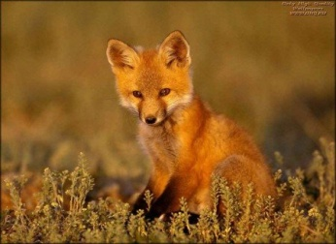
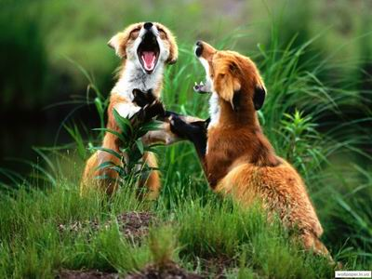
Look at, analyze and guess
How to pronounce the ending -ES? When?
[?] click on and check your idea [?] click on and check your idea
bus – buses potato – potatoes
glass - glasses
brush – brushes
bench - benches
BUT
radio - radios
piano - pianos
photo - photos video - videos
A fox
Two foxes

Slide 4
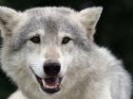
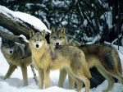
Look at, analyze and guess
How to pronounce the ending -IES? Click on and check your ideas
BUT
day – days
way – ways
Click on and check your ideas
Look at again, analyze and guess
Click on and check your idea
One butterfly
Two butterflies
One wolf Many wolves

Slide 5
It is important
We change something
We don’t change anything
foot – feet
tooth – teeth
goose – geese
man - men
woman – women
child – children
ox- oxen
datum – data
addendum – addenda
memorandum – memoranda
phenomenon – phenomena
basis – bases
crisis - crises
sheep – sheep
swine – swine
dozen –dozen (after numerals)
score – score (after numerals)
means- - means (средство / а)
works – works (завод / ы)

Slide 6
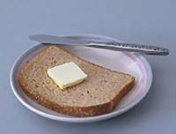
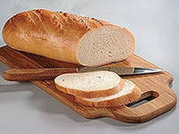
We can not count something
lemonade, butter, money, cheese, tea, coffee, water, jam, juice, meat, wood, milk, sugar, paper
iron, love, friendchip
We don’t say: I brought a bread
We must say: I brought some bread
bread

Slide 7
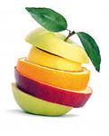
It is important
1. Study these sentences. What did you see?
Her hair is blond.
The money is on the table.
His knowledge is great.
The information is interesting.
Their progress is great.
He gave me some good advice.
Our summer vacation lasts two months.
Fruit is cheap in summer.
Click on and check your idea

Slide 8
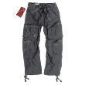
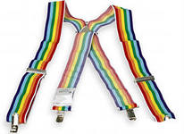
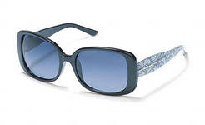
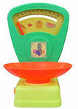
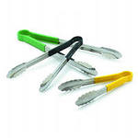
It is important
2. Look at these words. What did you see?
trousers
braces
scissors
glasses
(spectacles)
Scales
Tongs
Click on and check your idea

Slide 9
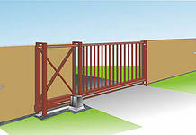
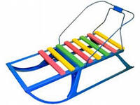
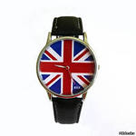
It is important
3. Look at these words. What did you see?
The gate is open.
All the gates were closed.
My sledge is good.
They bought one pair of sledges.
His watch (clock) is slow.
He has two watches.

Slide 10
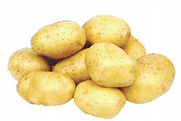
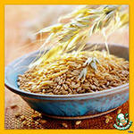
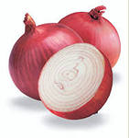
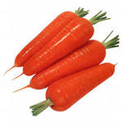
It is important
4. Look at these words. What did you see?
Potatoes are very cheap in autumn.
Картофель очень дешевый осенью.
They have good oats on the fields.
На полях у них хороший овес.
Onions are not delicious. – Лук не вкусный.
Carrots are yummy. – Морковь вкусная.

Slide 11
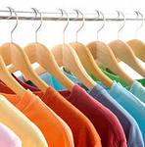
It is important
5. Look at these words. What did you see?
goods – товар / ы
riches - богатство / а
police
proceeds - выручка
wages – заработная плата
contents – содержание
сlothes – одежда
stairs – лестница
arms – оружие
Click on and check your ideas

