Slide 1
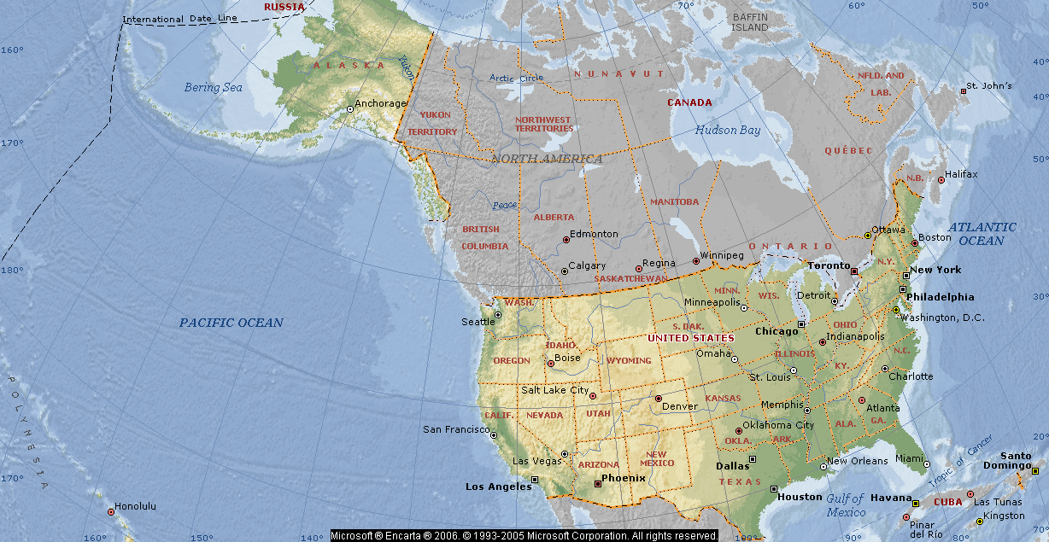
1. Make a sentence using the map to be washed by …. to the West

Slide 2
2. Write some sentences about
Area
9,826,630 sq km
Capital
Washington, D.C.
Largest cities, with population
New York 8,085,742
Los Angeles 3,819,951
Chicago 2,869,121
Houston 2,009,690
Philadelphia 1,479,339
Languages
English, Spanish, French, German, Italian, Chinese, and many others
Government
Form of government
Head of state
Head of government

Slide 3
3. Fill in the gaps States and Capitals of the United States
Use the map in your textbook, p/178-179
The United States consists of 1)………… states. Each state has a 2)…………….., which is the center of the state government.

Slide 4
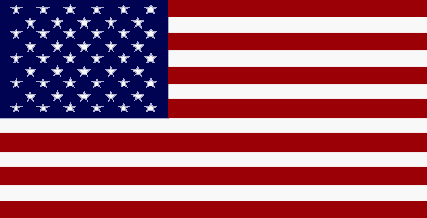
symbolize
stripes
corner
frequently
represent
popularly
five-pointed
4. Fill in the gaps
Flag of the United States, 1)……………. called the American flag, the official national flag of the United States.
It consists of 13 horizontal 2)…………., 7 red alternating with 6 white, and in the upper 3) …………..near the staff, a rectangular blue field containing 50 4) ………….white stars.
The stripes 5) …………… the 13 colonies that originally constituted the United States of America.
The stars 6) …………..the 50 states of the Union.
Because of its stars, stripes, and colors, the American flag is 7) …………… called the Star-Spangled Banner, the Stars and Stripes or the Red, White, and Blue.

Slide 5
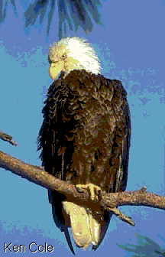
5. Think about good order
The bird eagle as designated the was United national of States in the bald 1782.

Slide 6
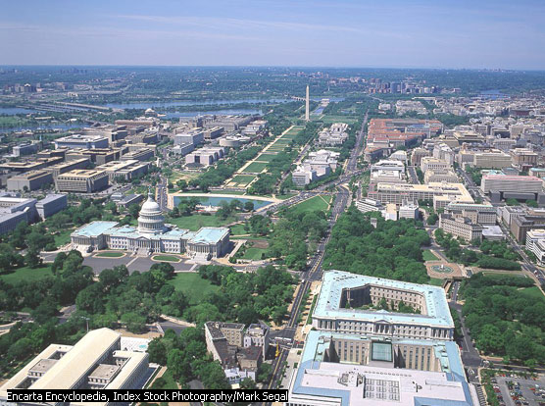
6. Find the meaning of the red words.
Washington, D.C., city and district, capital of the United States of America. The city of Washington has the same boundaries as the District of Columbia (D.C.), a federal territory established in 1790 as the site of the new nation’s permanent capital.

Slide 7
Keys
1. The USA are washed by the Atlantic Ocean to the West
3. 1)……50…… states 2)…head city……
4. 1) popularly 2) stripes 3) corner
4) five-pointed 5) symbolize
6) Represent 7) frequently
5. The bald eagle was designated as the national bird of the United States in 1782.
7. Boundaries – границы
established – создана, основана

