Slide 1
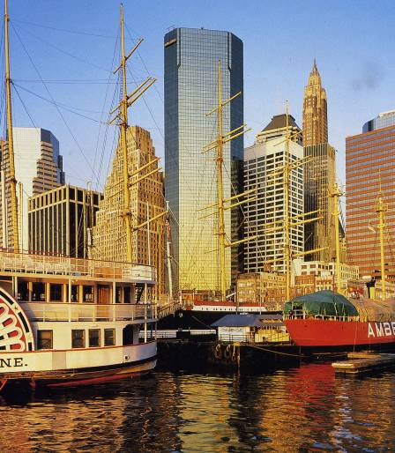
New York
“Big Apple”

Slide 2
1. Fill in the gaps. Use these adjectives: biggest cultural national financial important
It is the …… and most ………..city of the USA.
It is the …………and medial capital of the USA.
It is the headquarters of the United Nations.
It is the center of American …………..life .
It is the ………….leader in fashion and entertainment.

Slide 3
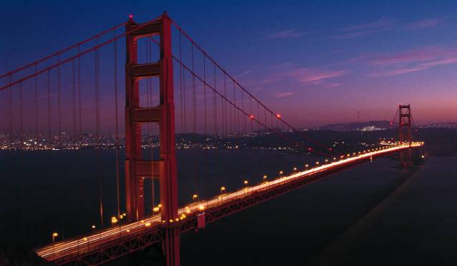
2. From the history… 1. Choose the best conjunction (that / who / whose / which). 2. Put commas. 3. Complete the last sentence talking about the parameters of this bridge (use the Internet).
The first European explorer …….. saw Manhattan Island was Giovanni da Verrazano, an Italian merchant. It was April, 1524.Today a bridge ……… carries his name, the Verrazano-Narrows Bridge, is one of the city’s impressive sights. It is the longest suspension bridge in the world …….
.

Slide 4
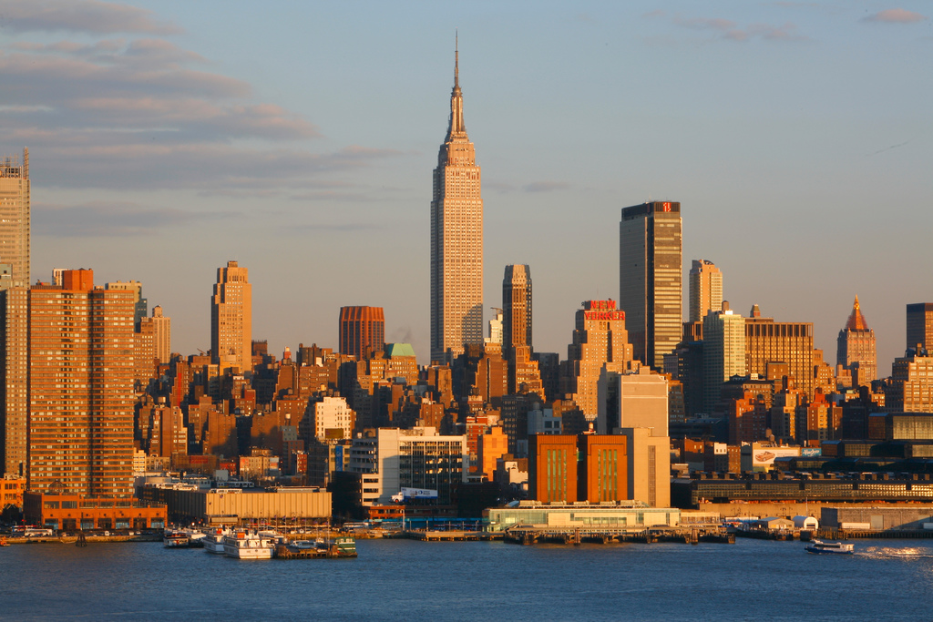
3. Put the parts of the text in a good order.
1.Each avenue has either a name or a number.
2. Only few of then have names.
3. The streets are numbered from one to over a hundred.
4.Manhattan is crossed by avenues from north to south and from east to west by streets.

Slide 5
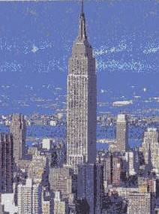
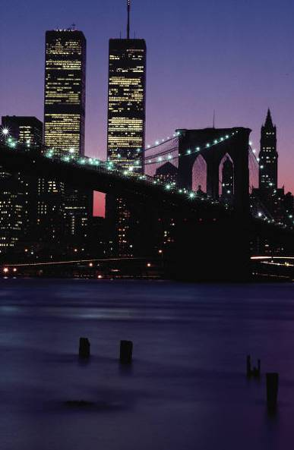
4. Compare the height of these buildings. Twin towers were ……. Than The Empire State building
The Empire State building
The World Trade Center
Twin towers of the World
Trade Center were the
highest skyscrapers in New
York. But they were
destroyed by the terrorist
attack in September 11,
2001.
is no longer the World’s tallest building, but it is certainly one of the world’s best loved skyscrapers.

Slide 6
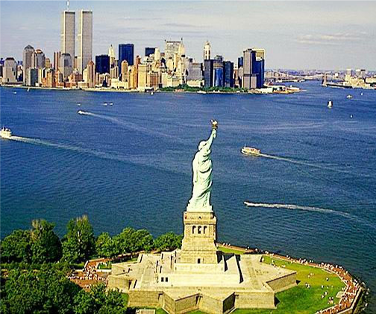
5. The Statue of Liberty Open the brackets
People who come to New York by sea 1) greet by the Statue of Liberty. It 2) become the symbol of the city. It 3) symbolize a welcome to a land of freedom.
The statue 4) be France’s gift to America, 5) present to the USA in 1886.There 6) is a museum in the base of the statue devoted to the history of immigration to the USA.

Slide 7
Keys
biggest , important, financial, cultural , national
The first European explorer who saw Manhattan Island was Giovanni da Verrazano, an Italian merchant. It was April, 1524.Today a bridge which carries his name, the Verrazano-Narrows Bridge, is one of the city’s impressive sights. It is the longest suspension bridge in the world whose length is 4,176 m, height is 211 m, longest 1,298 m, Vertical clearance, 4.57 m.
4 3 1 2
Heigher
1) are greeted 2) has become 3) symbolize
4) was 5) presented 6) is

