Slide 1
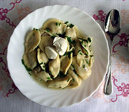
Pelmeni
Pelmeni (Russian: пельмени — plural, пельмень pel’men’ — singular) is Russian national dish (Siberian cuisine), a type of dumpling consisting of a filling that is wrapped in thin unleavened dough.

Slide 2
Ingredients
The dough is made from flour and water, sometimes adding a small portion of eggs.
The filling can be minced meat (pork, lamb, beef, or any other kinds of meat), fish, and mushrooms. The mixing together of different kinds of meat is also popular. The traditional Ural recipe requires a mixture of 45% beef, 35% mutton and 20% pork. Pelmeni in Perm (west of the Ural Mountains) are often filled with mushrooms, onions, turnips, or sauerkraut instead of meat. Various spices, such as black pepper and onions, are mixed into the filling.

Slide 3
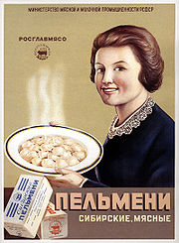
Origin and history
The word pelmeni is derived from pel'nyan' (пельнянь) – literally "ear bread" in the native Finno-Ugric Komi and Mansi languages. It is unclear when pelmeni entered the cuisines of indigenous Siberian people and when they first appeared in Russian cuisine. One theory suggests that pelmeni, or stuffed boiled dumplings in general, originated in China (thus explaining the use of spices such as black pepper, which are not native to Russia and had to be imported) and were carried by the Mongols to Siberia and the Urals, from where they gradually spread as far as Eastern Europe. Pelmeni were particularly favored by hunters, who were looking for light, easy-to-prepare, nourishing food to take with them frozen on long hunting trips in the winter.

Slide 4
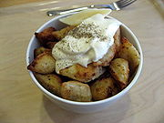
Regional differences
In Siberia, pelmeni are traditionally frozen outdoors in the winter and treated as preserved food. Hunters or explorers heading into the taiga would carry sacs of frozen pelmeni with their provisions as easily cooked non-perishable food. Pelmeni can be stored frozen for a long time and they are prepared immediately before eating by boiling in water until they float, and then 2–5 minutes more. Regional differences exist in the boiling of pelmeni. In the Urals, they are always boiled in water, while in Siberia they are boiled in meat or chicken broth. The cooked pelmeni are served on their own or topped with melted butter or sour cream. Mustard, horseradish, tomato sauce, and vinegar are popular as well. Some recipes suggest frying pelmeni after boiling until they turn golden brown. Pelmeni can also be served in a clear soup, although in Siberia this is considered in poor taste and pelmeni are carefully strained before serving.
Packed frozen, pelmeni can be found in Russian and Ukrainian food stores as well as everywhere Russian communities exist. Packets of frozen pelmeni are usually labeled "Siberian pelmeni" because of the Siberian practice of storing and transporting pelmeni in frozen form. Store-bought pelmeni are made on industrial machinery, much of which is made by Italian companies such as Arienti & Cattaneo, Ima, Ostoni, Zamboni, etc. These pelmeni usually weigh around 15 grams each and look like a larger version of tortellini, which is why for, industrial production, Italian pasta machines are commonly used.
In modern Russian and Ukrainian culture store-bought pelmeni are considered a kind of a fast-food and are associated with students' or bachelors' lifestyle, much like instant ramen etc.

